Slide 1
Coming together
Hillary Juma
Data Science Community and Engagement Manager, ONS Data Science Campus
she/her, delightfully dyslexic
Government Data Science Partnership is a collaboration between ONS, GDS and GoScience
Notes:
Hello, my name is Hillary and Thank you so much for NHS-R Community Conference team for inviting me to speak with your community. I have really enjoyed hearing about the amazing work of your community. I’ve joined listening to presentations such as hexitime.
I’m a community and engagement manager I work with the data science community members and Government Data Science Partnership (ONS, Office for science and GDS) . My role within the partnership is to help facilitate and create space for knowledge sharing within the community.
I am based in the Office for National Statistics, Data Science Campus. Our motto is using Data Science for public good. The campus has produced publications such as faster indicators of the economy, the projects uses novel data such as AIS shipping indicators, Majesty’s Revenue and Customs (HMRC) Value Added Returns, road traffic flow data for England to provide an early picture of activity that supplements official economic statistics.
The campus also works with government and public sector organisation to build there data science capability. We deliver a range of different programs such as direct delivery of learning. Programmes such as the Msc Data Analytics in Government and Accelerator. Building a pipeline of data science talent through apprenticeships at different levels and our graduate programme. More details on the website.
So why are we here today ?
To connect, learn and share from one another.
One way, I enjoy coming together with people is through music, in particular singing.
This presentation, will explain how and what key elements have enabled the government data science community to come together. Through a song.

Slide 2
For a chance at loving you
I'd take it all the way
A philia type of love
Notes:
One of my favourite songs is Through the fire by Chaka Khan it's a love song about trials and tribulations.
The first line of the song goes: “For a chance at loving you I'd take it all the way”. For the purpose of this talk, I am not talking about romantic love but phillia type of love.
In greek philosophy love exists in different ways. Philia is a type of love that focuses on friendship, an example of how philia is demonstrated by the a quote from aristotle's "wanting for someone what one thinks good, for his sake and not for one's own, and being inclined, so far as one can, to do such things for him" (1380b36–1381a2)”.
Communities are relational, built on connections and experiences of its members. Think of the communities you are part, of friends you have made along the way.
(check pronunciation)

Slide 3
What is the gov data science community ?
Notes:
What is the gov data science community ?
People -> the community is made of data science practitioners and enablers working in the public sector. For example analysts, statisticians, data scientist and programme managers. What brings them together is the common interest in using data science for the public good, in analysis, operational purposes and public products.
To give an example of the work community members have done:
Queen’s Hospital Trusts: developing a pilot app using machine learning to assist triaging in accidents and emergencies,
UKHO: deep learning to mapp mangrove forests and swamps
On Gov.uk data science community manual is a reference tool of our purposes:
bring together data scientists and improve data science capability across government
develop and share data science best practice
help digital and other analytical teams work effectively with data scientists
discuss and challenge the way government uses machine learning and artificial intelligence to improve services

Slide 4
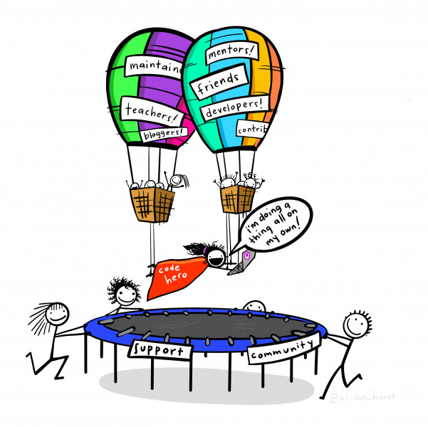
Learning and Development
70 % Challenging assignments
20 %Developmental relationships
10 %Formal Training
Notes:
You may have heard within Learning and Development the 70/20/10 learning model on how we develop during our professional life.
70% of the time from challenging assignments/ e.g working on a project that stretches your applied skills
20% of the time from developmental relationships/ communities, mentoring
10% of the time from coursework and training/ e.g 1st week of NHS-R Conference
Allison Horst, one of my favourite data communicators.
Interpret Allison’s images as a “code hero” is not Superman in his fortress of solitude but exist in rich and living legacy of bloggers, mentors, friends and more….

Slide 5
Right down to the wire, even through the fire
Life
Notes:
Going back to our song; Right down to the wire, even through the fire. This line focuses on life's challenges.
Some days are sunny, some days are storms.
Communities store tacit knowledge and help bridge silhos,

Slide 6
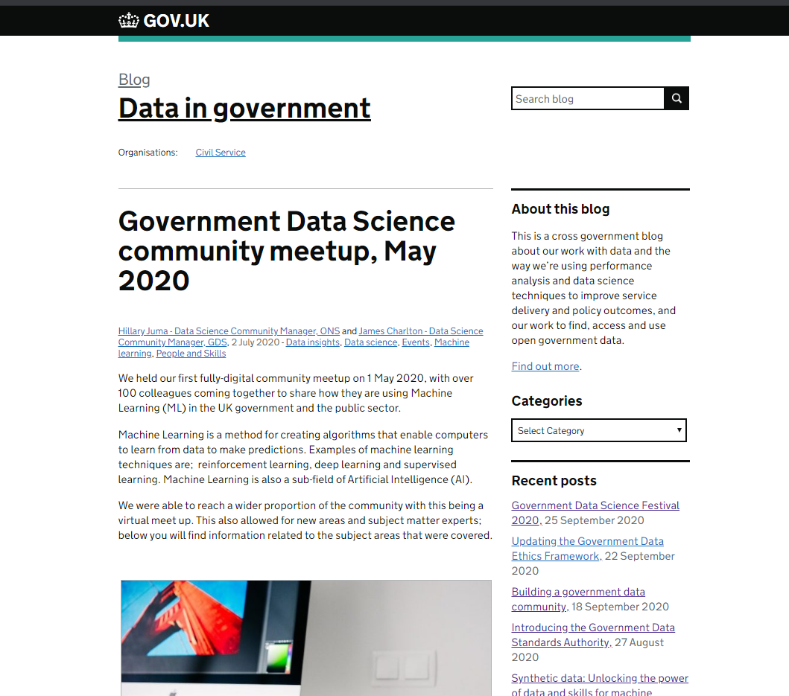
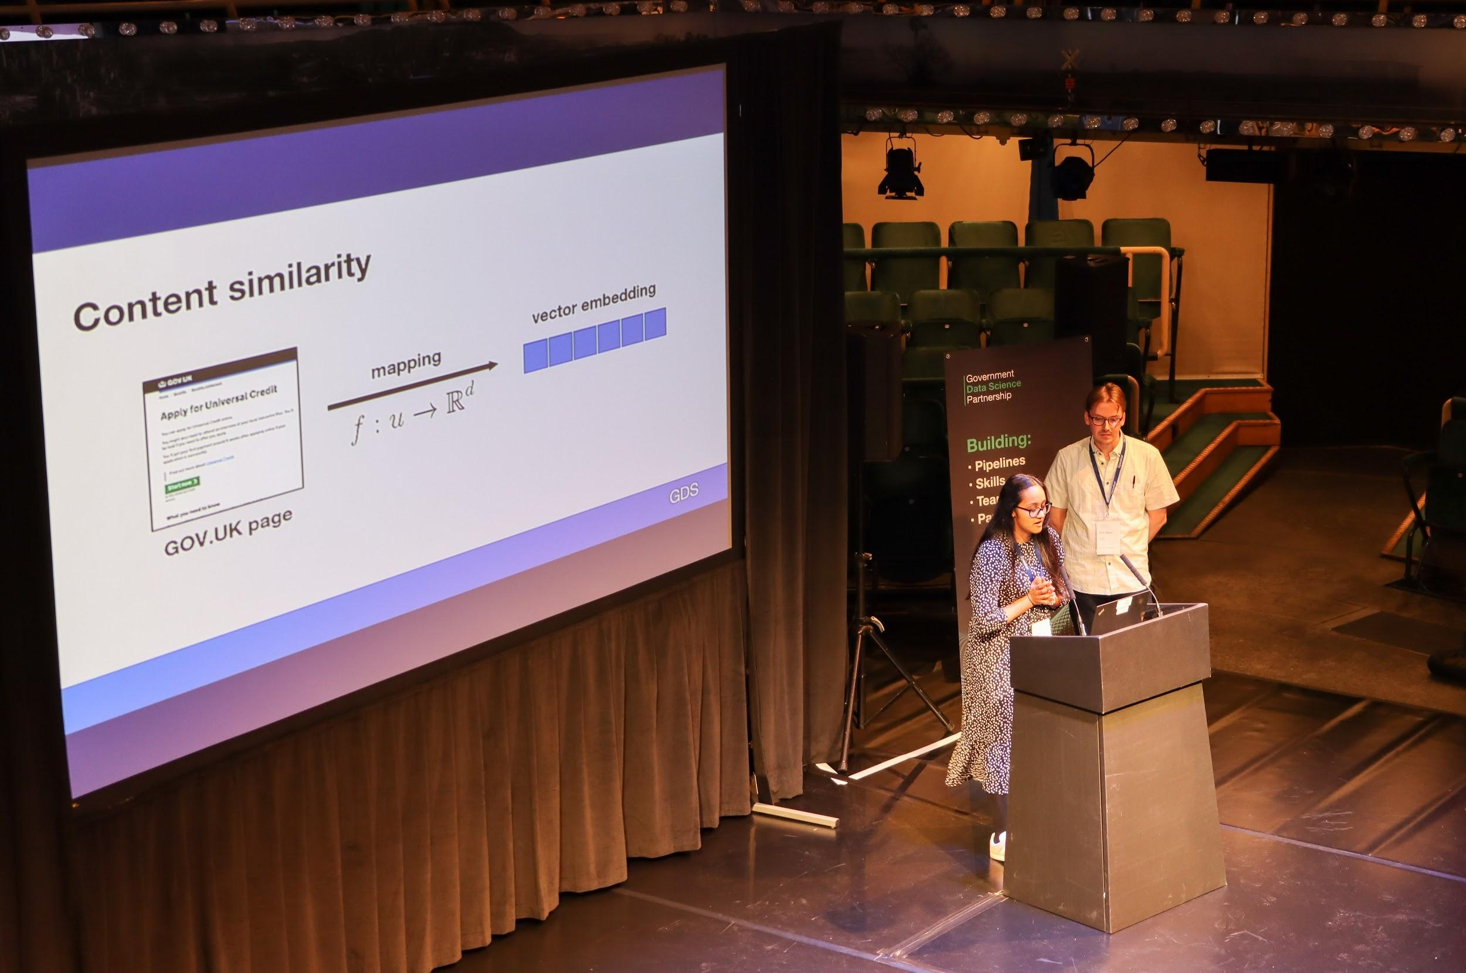
Notes:
Coming together enables this.
Every 2 to 3 months we a data science community of interests, to connect and showcase the work of members. The image on the left is a screen shot from Data In Government Blog on GOV.UK covering what happened at our May meet up on Machine Learning. We have also focused on geospatial data science, NLP and careers. At the meet ups, members have taken part in panels, presented about their experiences on projects, senior leaders taken part in Ask Me Anythings, so others can learn. To note: we have a meet up next week on COVID-19, Brexit and Wellbeing with presenters from JBC (Join Biosecurity Centre) , DiT (Department in Transport), HMRC and more.
Annually we host a we host a conference where colleagues can connect, share what they are working on around a theme.
The photo is from our annual conference last year, in Manchester on “building data science, skills, partnerships, capability and pipelines”.
Most recently our first fully digital festival happen in september focusing on how data science is being used x-public sector enable the new normal that pandemic has brought. Focusing on different sub themes such as operalising data science to trust, confidentiality and transparency.

Slide 7
Community groups
RAP Champions
Departmental Coffee and Codings
Analytical Platforms
Notes:
Data Science Community groups are run by different groups:
Self-organising
GDSP (Government Data Science Partnership) - supporting
GSS (Government Statistical Service) -supporting
RAP Champions supported by GSS Best Practice Team. Who champion the use of Reproducible Analytical Pipelines.
This means promoting reproducible analysis (i.e. analysis with a clear audit trail that explains how and why it was carried out) and the use of reproducible analytical pipelines (i.e. the software methods used to make analysis reproducible).
Champions are expected to share their knowledge and provide advice and support to members of the analytical community who want to learn about and implement reproducible analysis and reproducible analytical pipelines.
Departmental Coffee and Codings , usually one hour presentations where colleagues are how they have used code to create X, for example: Building a python package for reproducible statistical tables, End-to-End Machine Learning and more.. Most departments have shared their presenters code on their githubs. I’m happy to share the links to the ONS ones afterwards.
Analytical Platforms, colleagues who annually audit analytical platforms to help colleagues make business cases.

Slide 8
Community groups
Text Analytical Community
X-GOV C-19 Coffee Mornings
Data Science: Ethics and Society Reading Group
Notes:
Text Analytical community seeks to unlock the value of text analytics and Natural Language processing in the public sector. Currently we are going through a consultation to help co-create the community group programme.
X-GOV C-19 coffee morning, we meet every other week to discuss C-19 related analysis we have been doing and document what we share. If you are interested please email me (email at the end).
Data Science: Ethics and Society reading group based at the ONS, gathers seasonally to discuss a theme within data ethics and society. We recently finished a season on the book data feminism. Supplementary reading included data ethics frameworks and videos on interesting talks. Our github repo showcases what we have covered. To note we have chatham house rules (aka what is discussed doesn’t leave the room).

Slide 9
Community Platforms
Government Data Science Slack
Example channels #R #Python #Training #NLP #connect #analytical_platforms #RAPchampions
Mailing lists/ distribution lists
Data in Government Blog
Notes:
One of our major platforms is slack, a messaging platform for our community to connect, coordinate and share.
Examples of some of the channels are listed above. We also have a channel called connect, that enables colleagues to catch up one on one/ small groups.
Government Data Science mailing list -> share what community events and initiatives we are supporting. For example early on in the pandemic we created a volunteering scheme where colleagues could support different teams with capability needs.
Data in Government blog on GOV.UK -> storing community knowledge

Slide 10
Data Science Accelerator
Develop your data science skills through mentorship and applied learning.
Notes:
Back to my favourite artists: Allison Horst. Ou
the community and GDSP believe in supporting data science skills development. One of the key ways in which we do so is the Data Science Accelerator. Mentors from the community match with mentees who are looking to develop data science skills.
Over the course of 12 weeks, mentees have a protected time once a week to develop their data science project with mentees.
Including the current cohort, there have been 243 participants in total since the programme started in 2015.
To give an example of the projects…
A mentee at DEFRA, made a project on “Mapping vessel satellite and landings data”
The mentee developed an online tool that maps landing data by user-specified inputs. It allows users to query and visualise data. It has also reduced the number of requests to the Marine Management Organisation.
A mentee at HMRC, made a project “Classifying businesses using text descriptions”
The mentee created A classifier was developed that classified 85% of traders correctly across the largest trade classes. HM Revenue & Customs showed an interest in turning this into a production-standard tool.
Next cohort runs ...Run in March/ Open towards the end of January

Slide 11
I can help if you'll only let me try
Radical Inclusion
Notes:
Back to our song: “I can help if you’ll only let me try”
When someone offers help, we usually asses the why and how before agreeing to do so.
Help has to be consensual and radically inclusive to be effective.
So when we asses and design event we ask...

Slide 12
Who are we excluding ?
How do we enable new ideas from members ?
When do we take time to reflect ?
What could we do better and what should we stop doing ?
Notes:
Who are we excluding ?
How do we enable new ideas from members ?
When do we take time to reflect ?
What could we do better and what should we stop doing ?
When designing events we try and ensure at the best of our ability that there is an equal gender split between presenters.
Working a cross-government there are difference in technology platforms, we try our best to ensure the platforms can be accessed by all and make concessions.
In our retrospectives we ask colleagues to let us know if they feel excluded by anything we have done, and we make changes where possible.
Also encourage our members to share their skills with others via signposting volunteering activities aimed at increasing underrepresented within in our industry which could have an impact on future members demographics.

Slide 13
You touched me and something in me knew
What I could have with you
Impact and beyond
Notes:
For the last part of the song I would like to emphasis on is “You touched me and something in me knew What I could have with you”.
This part of the song is about the emotional impact that people experience in relation to one another. That consequently enables them to look at the future of what they want to co-create.
I would like to share with you a story about one of our community groups.

Slide 14
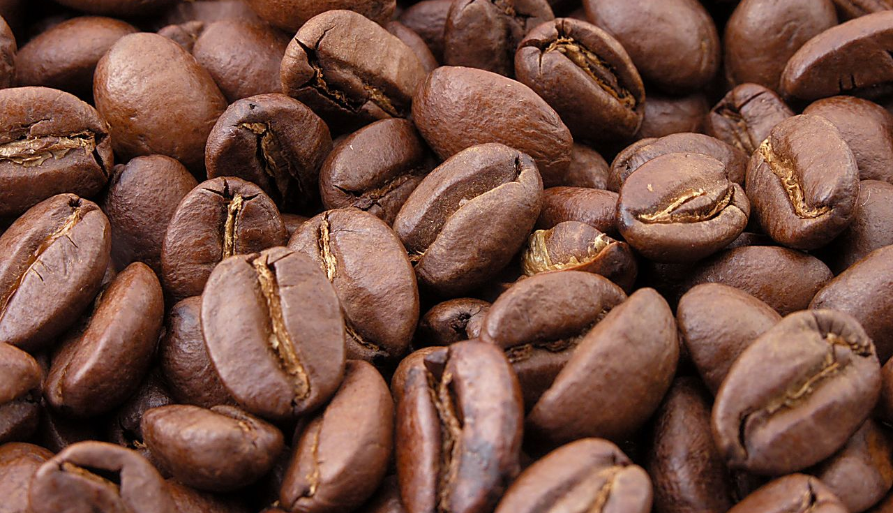
Notes:
Life has radically been shifted this year by the pandemic. The pandemic, impacts multiple spheres within the public sector.
To support colleagues working on C-19 Work we have been hosting data science coffee mornings.
Like a stand ups where people can share what they are working on, ask for help or provide offers.
Connecting practitioners has enabled sharing of methodologies, data sources and a supportive community during these challenging times.
Furthermore, helping to avoid duplication and encouraging the reproduction of code.

Slide 15
Impact and beyond
Collaboration metrics
Social Audits
Community history
Reach, retro and renewal
Notes:
Collaboration Metrics: 3667 members connecting on helping each other solve common or unique problems
Social Audits -> Interviewing people one on one to share their experience in the community and their roles
Community history -> Mapping our community history on Data in Government on GOV.UK
Host retrospectives on community initiatives to inform our renewal and way forward with our community roadmap.

Slide 16
Communities thrive on….
Purpose
People
Platform
Programme
And most importantly philia
Notes:
Communities thrive
On having a common purpose, people happy in relation to one another, platforms that are accessible and programmes that are relevant and thought provoking.
Going back to greek philosophy love exists in different ways. Philia is a type of love that focuses on friendship, an example of how philia is demonstrated by the a quote from aristotle's "wanting for someone what one thinks good, for his sake and not for one's own, and being inclined, so far as one can, to do such things for him" (1380b36–1381a2)”.
There so many opportunities to connect with colleagues this week, I’ve been moved and inspired so much by the presentations I’ve listened to. I want to keep on learning from and I also want to encourage you to keep going.

Slide 17
Thank you, I’m happy to take questions
Hillary Juma
Data Science Community and Engagement Manager, ONS Data Science Campus
hillary.juma@ons.gov.uk
Government Data Science Partnership is a collaboration between ONS, GDS and GoScience

Slide 18
Index
Data Science
Data Science Campus
Applying the tools, methods and practices of the digital and data age to create new understanding and improve decision-making.

Slide 19
Useful Links
Data Science Community Service Manual
Data in Government Blog
The Dstl Biscuit Book on Artificial Intelligence (AI), Data Science and Machine Learning
Data Science Campus
Data Science Campus Github
Government Data Science Community of Interest
Reproducible Analytical Pipelines in R, Udemy
Government Analytical Function Career Framework

